Slide 1

AUTONOMOUS SHIPPING Voorbereidende presentatie
Jasper Vlaar, Jelte Molenaar, Job Vink, Michiel van Soest en Martin de Rijke

Slide 2
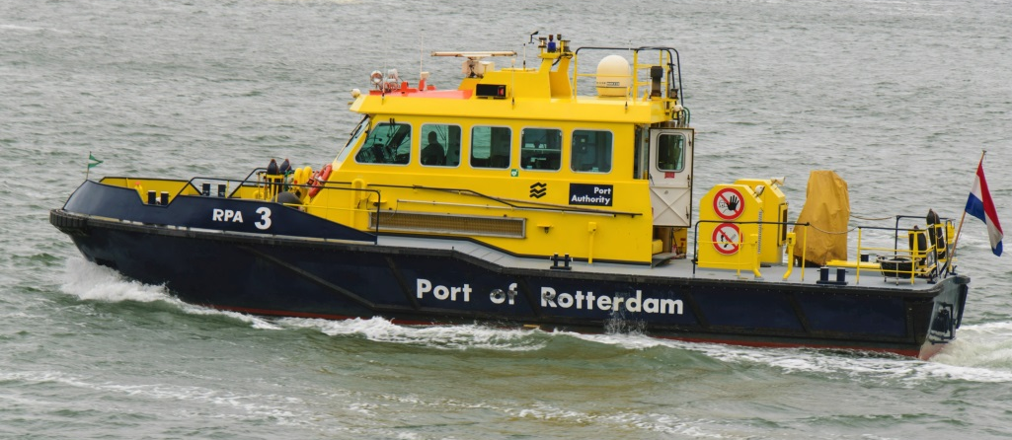
Sprint 1 - Content
Project Purpose
Project approach
Stereo Cameras

Slide 3
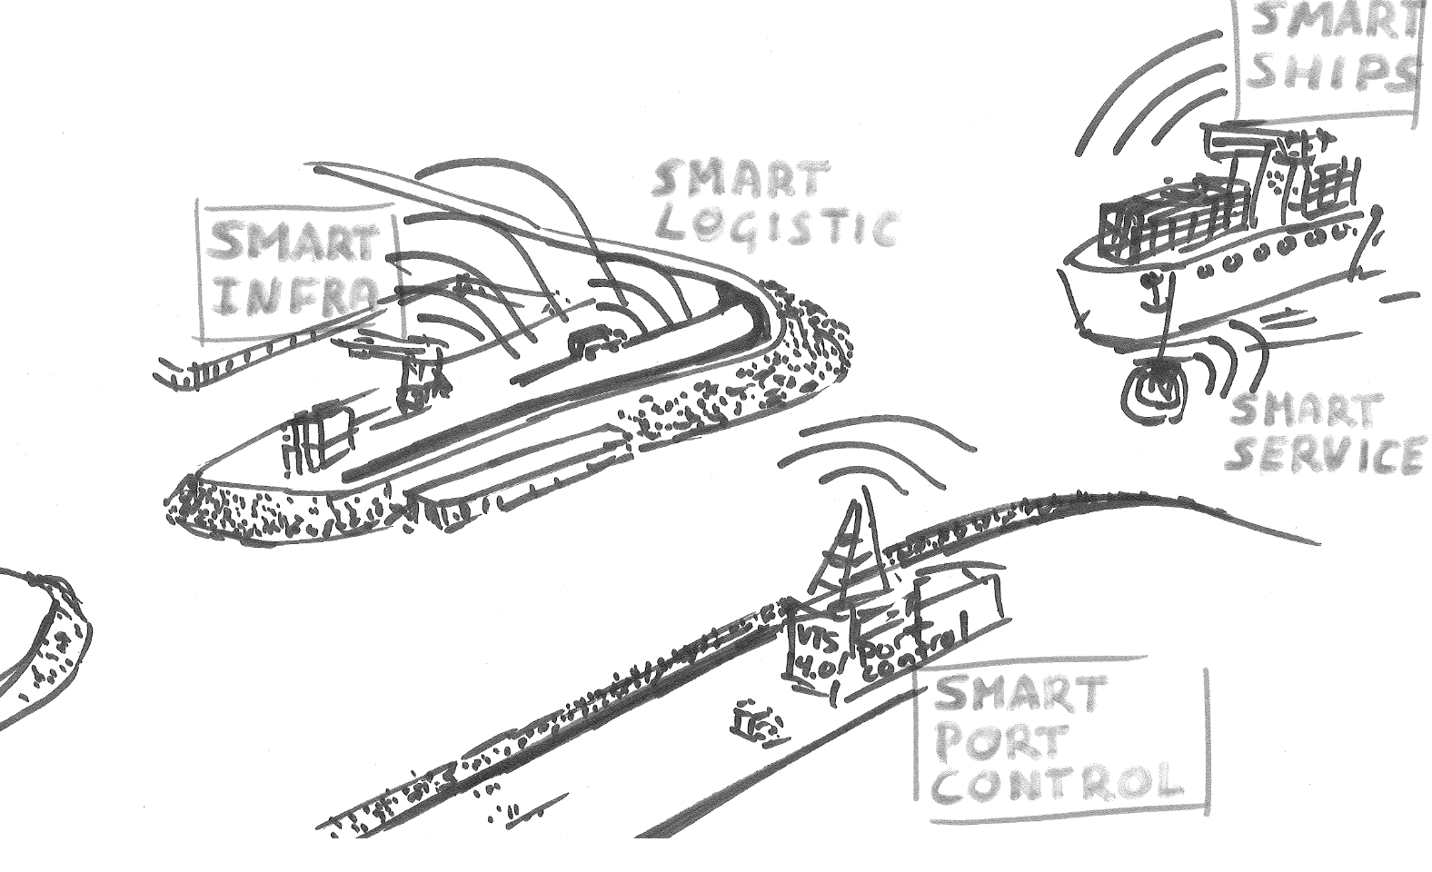
Project Purpose

Slide 4
Project Approach

Slide 5
Research Results

Slide 6
Tools

